Slide 1

2D GAME DEVELOPMENT
CANDY CRAFTER
Presented By:
Prabal Goyal
17csu137

Slide 2
STORY
Game would be a story of a candy factory where the candies need to be packed together in a set of more than two.
Various constraint factors must be met on each level
The candy factory have to meet the consumer demand on every level.

Slide 3
GAME PLAY
The game would be a 2d platformer where on the first level we have a limited number of workers (i.e. that is a limited number of moves) in the factory to pack the candies. Workers have to try to pack the maximum number of the same type of candies together to maximize the profit.
On the second level, the Objective of the game remains the same, but some un-acceptable candies are produced which are represented in the form of bubbles. Workers have to pack the candies and at the same time remove the un-acceptable candies too.
On the third and the final level, we have a time constraint (i.e. there is limited time) to adhere to as well as maximize the profit by packing the maximum number of candies together.

Slide 4
GAME DESIGN
Background will be a candy factory theme.
PLAYER CONTROL
Packing of similar candies can be done using touch screens in an android phone.
OBSTACLES
Level 1 – Limited number of moves
Level 2 – Limited number of the move while removing all the bubble s
Level 3 – Limited time constraint

Slide 5
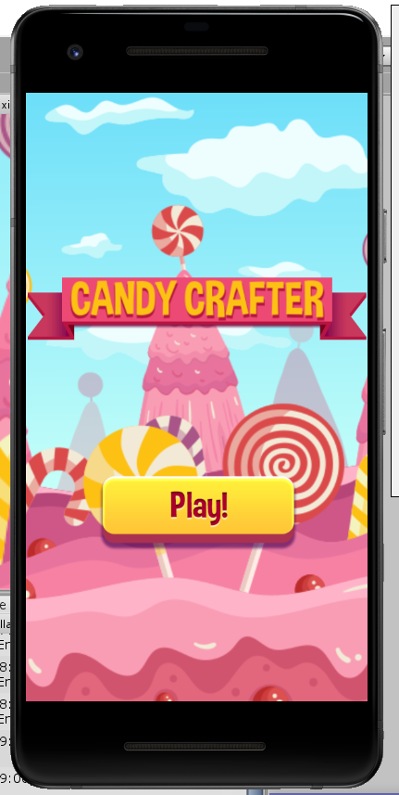
HOME SCREEN

Slide 6
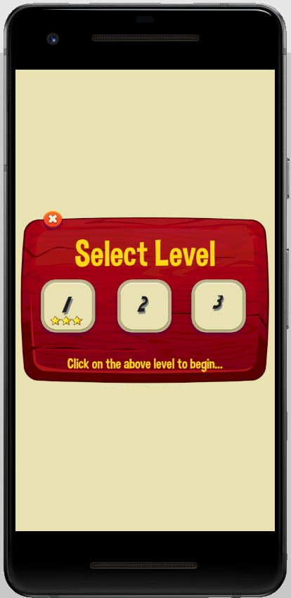
LEVEL SELECT

Slide 7
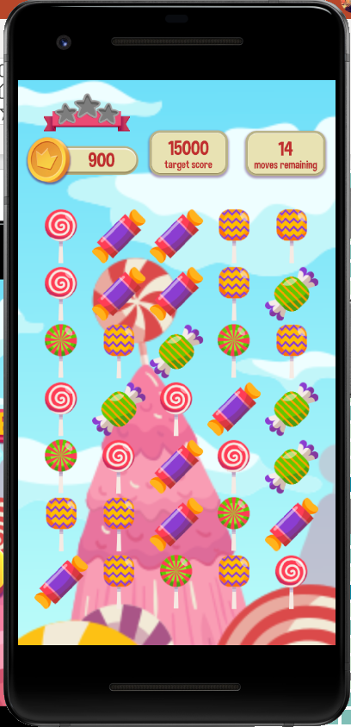
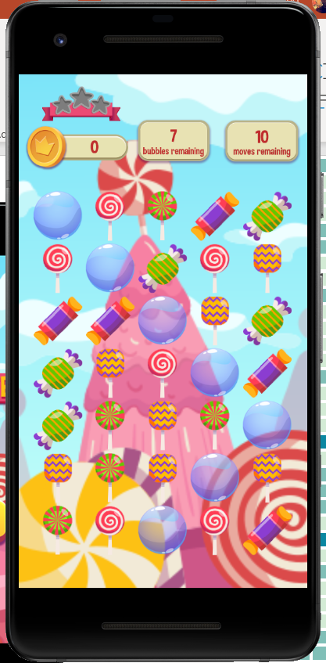
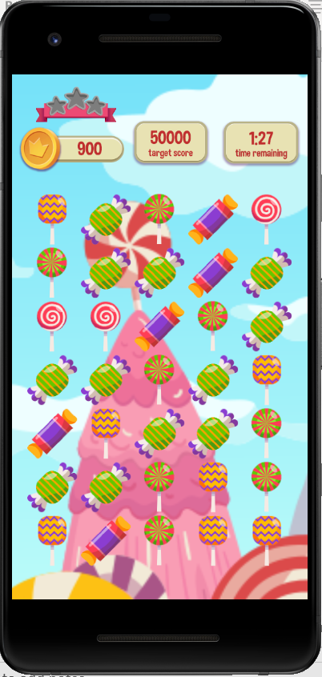
LEVEL 1
LEVEL 2
LEVEL 3

Slide 8

RECORDING

Slide 9

THANK YOU

